Slide 1

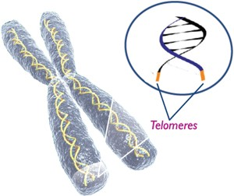
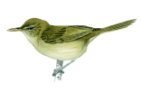
Altruism, infidelity and telomeres
David S Richardson
Lewis Spurgin

Slide 2
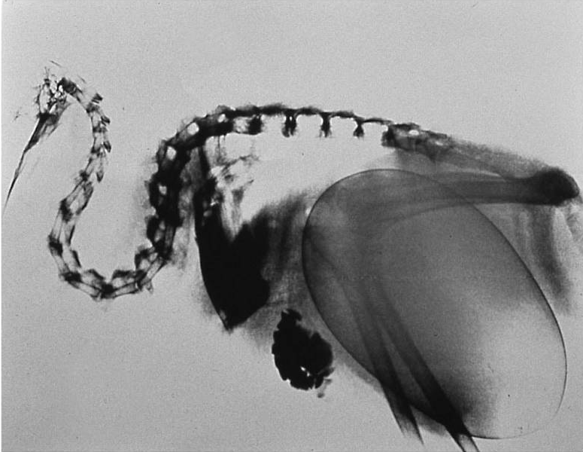
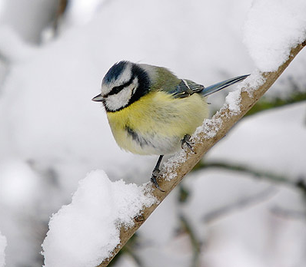
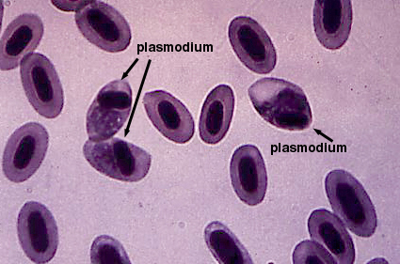
Cost and trade-offs in the struggle to survive and reproduce
Notes:
Because resources, and the time it take to acquire them, are limited, every organism has a finite amount it can use in its’ efforts to survive and reproduce. Resources spent on one area, cannot be spent on another,. Consequently organisms must trade off how best to spend their resources so as to maximise the benefits they gain.
Such trade-offs are central to our understanding of the evolution, for example why different life-history strategies evolve, i.e. why different organisms differ in aspects such as size, reproduction rate and lifespan, a fundamental part of biology.
The problem is that, although it is often relatively easy to assess the benefit of investment in an area, to understand trade-offs we also need to know the costs. Unfortunately, measuring such costs has proved to be extremely difficult, especially in wild living animals
What we need is universal measure – a generic currency with which we can measure and compare all these factors
Quantifying such costs using a universal measure would allow us to determine their relative impact within and between organisms

Slide 3
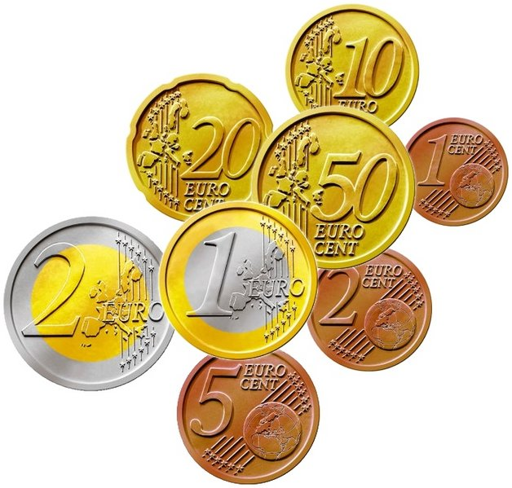
Cost and trade-offs in the struggle to survive and reproduce
Notes:
Because resources, and the time it take to acquire them, are limited, every organism has a finite amount it can use in its’ efforts to survive and reproduce. Resources spent on one area, cannot be spent on another,. Consequently organisms must trade off how best to spend their resources so as to maximise the benefits they gain.
Such trade-offs are central to our understanding of the evolution, for example why different life-history strategies evolve, i.e. why different organisms differ in aspects such as size, reproduction rate and lifespan, a fundamental part of biology.
The problem is that, although it is often relatively easy to assess the benefit of investment in an area, to understand trade-offs we also need to know the costs. Unfortunately, measuring such costs has proved to be extremely difficult, especially in wild living animals
What we need is universal measure – a generic currency with which we can measure and compare all these factors
Quantifying such costs using a universal measure would allow us to determine their relative impact within and between organisms

Slide 4
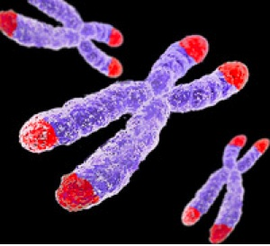
Telomeres
…TTAGGGTTAGGGTTAGGGTTAGGG… …AATCCCAAT CCCAATCCC AATCCC…
(TTAGGG)_{n}
in vertebrates
Inheritance
Replication History (age)
Oxidative Damage
Notes:
Specialized regions of repetitive DNA
Act as ‘caps’ to protect the ends of chromosomes
Prevent chromosome degradation or fusion during division (mitosis or mieosis

Slide 5
Telomeres as biomarkers of cost and quality in a wild population
Notes:
The idea?

Slide 6
Telomeres as biomarkers of cost and quality in a wild population
If you measure telomere length in individuals and control for chronological age:
Notes:
The idea?

Slide 7
Telomeres as biomarkers of cost and quality in a wild population
If you measure telomere length in individuals and control for chronological age:
= Marker of biological ageing
Notes:
The idea?

Slide 8
Telomeres as biomarkers of cost and quality in a wild population
If you measure telomere length in individuals and control for chronological age:
= Marker of biological ageing
If you isolate telomere shortening during specific experiences:
Notes:
The idea?

Slide 9
Telomeres as biomarkers of cost and quality in a wild population
If you measure telomere length in individuals and control for chronological age:
= Marker of biological ageing
If you isolate telomere shortening during specific experiences:
= Biomarker of the costs of such experiences
Notes:
The idea?

Slide 10
Telomeres as biomarkers of cost and quality in a wild population
If you measure telomere length in individuals and control for chronological age:
= Marker of biological ageing
If you isolate telomere shortening during specific experiences:
= Biomarker of the costs of such experiences
If you control for age and telomere shortening factors:
Notes:
The idea?

Slide 11
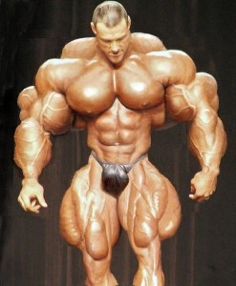
Telomeres as biomarkers of cost and quality in a wild population
If you measure telomere length in individuals and control for chronological age:
= Marker of biological ageing
If you isolate telomere shortening during specific experiences:
= Biomarker of the costs of such experiences
If you control for age and telomere shortening factors:
= Measure of individual quality
Notes:
The idea?

Slide 12


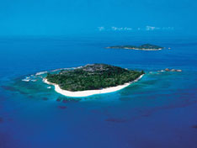
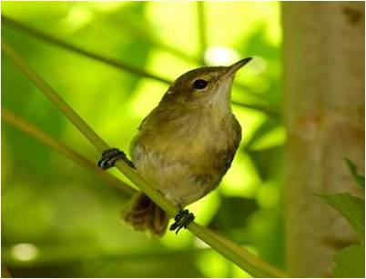



]
Seychelles Warbler
Acrocephalus sechellensis
ICBP

Slide 13

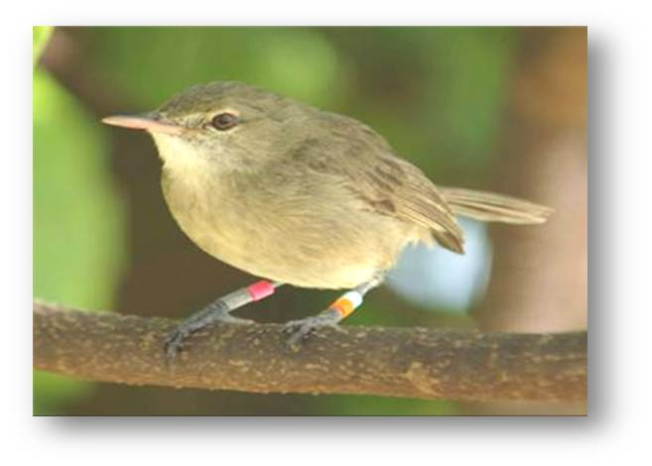
The SW system: a closed population
Cousin island (studied since 1985)
Notes:
Small, isolated and enclosed population, >97% birds colour ringed ,
Inititally bled and rung as chicks or fledglings
Exact chronological age known,
Life history parameters known, Other experiences – e.g. infection etc , Genetic parameters

Slide 14
The SW system: a closed population
Cousin island (studied since 1985)
Small, isolated and enclosed population
> 97% birds colour ringed
Notes:
Small, isolated and enclosed population, >97% birds colour ringed ,
Inititally bled and rung as chicks or fledglings
Exact chronological age known,
Life history parameters known, Other experiences – e.g. infection etc , Genetic parameters

Slide 15
The SW system: a closed population
Cousin island (studied since 1985)
Small, isolated and enclosed population
> 97% birds colour ringed
Repeatedly blood sampled since 1994
Notes:
Small, isolated and enclosed population, >97% birds colour ringed ,
Inititally bled and rung as chicks or fledglings
Exact chronological age known,
Life history parameters known, Other experiences – e.g. infection etc , Genetic parameters

Slide 16
The SW system: a closed population
Cousin island (studied since 1985)
Small, isolated and enclosed population
> 97% birds colour ringed
Repeatedly blood sampled since 1994
Exact chronological age known
18 year pedigree being completed
Life history parameters known
Other experiences – e.g. malaria infection
Notes:
Small, isolated and enclosed population, >97% birds colour ringed ,
Inititally bled and rung as chicks or fledglings
Exact chronological age known,
Life history parameters known, Other experiences – e.g. infection etc , Genetic parameters

Slide 17
The SW system: mostly intrinsic mortality

Slide 18
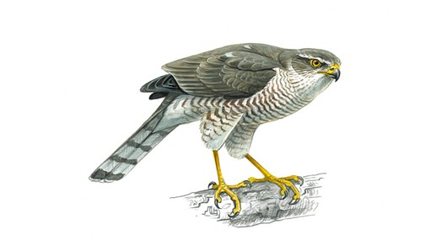
The SW system: mostly intrinsic mortality

Slide 19
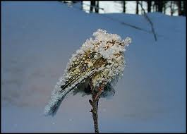
The SW system: mostly intrinsic mortality

Slide 20

The SW system: mostly intrinsic mortality

Slide 21
The SW system: mostly intrinsic mortality
x
x
x

Slide 22
Understanding fundamental biological questions
Notes:
Need to emphasis that to really understand these things we need to understand the costs as well as the benefits

Slide 23
Understanding fundamental biological questions
Altruism
The evolution of cooperative breeding
Notes:
Need to emphasis that to really understand these things we need to understand the costs as well as the benefits

Slide 24
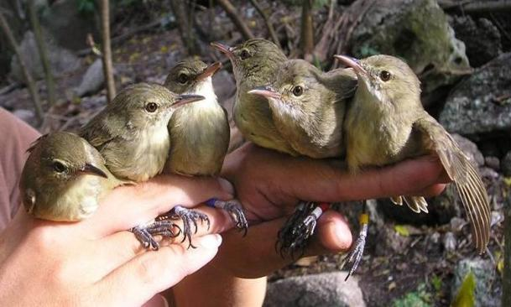
Understanding fundamental biological questions
Altruism
The evolution of cooperative breeding
Dominant pair
subordinates
+
offspring
Notes:
Need to emphasis that to really understand these things we need to understand the costs as well as the benefits

Slide 25
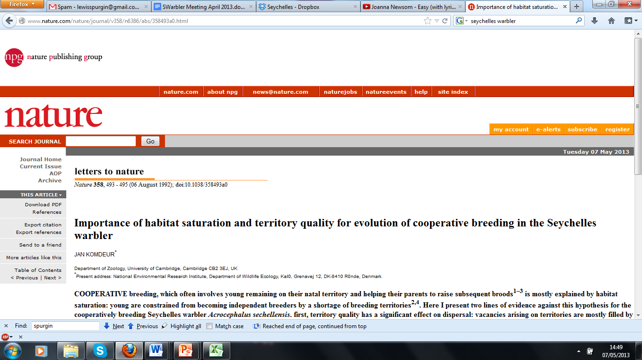
Understanding fundamental biological questions
Altruism
The evolution of cooperative breeding
Dominant pair
subordinates
+
offspring
Notes:
Need to emphasis that to really understand these things we need to understand the costs as well as the benefits

Slide 26
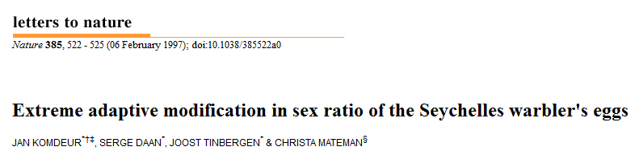
Understanding fundamental biological questions
Altruism
The evolution of cooperative breeding
Dominant pair
subordinates
+
offspring
Notes:
Need to emphasis that to really understand these things we need to understand the costs as well as the benefits

Slide 27
Understanding fundamental biological questions
Altruism
The evolution of cooperative breeding
Dominant pair
subordinates
+
offspring
Notes:
Need to emphasis that to really understand these things we need to understand the costs as well as the benefits

Slide 28
Understanding fundamental biological questions
Altruism
The evolution of cooperative breeding
Dominant pair
subordinates
+
offspring
Notes:
Need to emphasis that to really understand these things we need to understand the costs as well as the benefits

Slide 29
Understanding fundamental biological questions
Altruism
The evolution of cooperative breeding
Dominant pair
subordinates
+
offspring
Costs and Benefits
Notes:
Need to emphasis that to really understand these things we need to understand the costs as well as the benefits

Slide 30
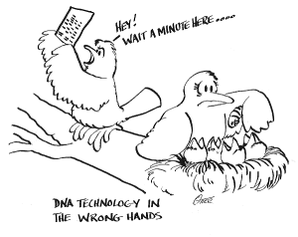
Infidelity The benefits of (extra-pair) mate choice
Understanding fundamental biological questions

Slide 31
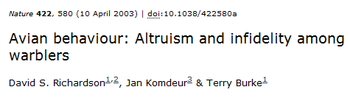
Infidelity The benefits of (extra-pair) mate choice
Understanding fundamental biological questions

Slide 32
Infidelity The benefits of (extra-pair) mate choice
Understanding fundamental biological questions

Slide 33
Infidelity The benefits of (extra-pair) mate choice
Understanding fundamental biological questions

Slide 34
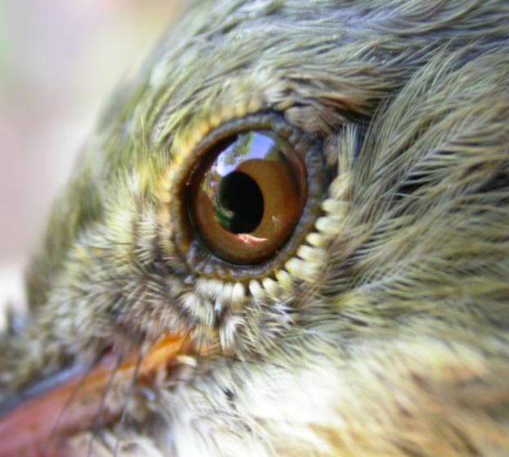
Overall Aims
Assess individual variation in telomere length/shortening

Slide 35
Overall Aims
Assess individual variation in telomere length/shortening
Are telomere dynamics linked to survival / longevity (Biological ageing)

Slide 36
Overall Aims
Assess individual variation in telomere length/shortening
Are telomere dynamics linked to survival / longevity (Biological ageing)
How strategies/experiences affect telomere shortening (Generic currency)

Slide 37
Overall Aims
Assess individual variation in telomere length/shortening
Are telomere dynamics linked to survival / longevity (Biological ageing)
How strategies/experiences affect telomere shortening (Generic currency)
If individuals differ in response to these factors (Individual quality)

Slide 38
Results: adult telomere length
Notes:
The slope within individuals (black line) was not significantly different to the slope between individuals (dotted line). To analyse whether the relationship between telomeres and age was comparable within and between individuals, we split the age variable into two terms for each bird: the mean age (ß_{B}; Fig. 1c); and deviation from the mean age (Δ age or ß_{W}; Fig. 1d).
Within and between individual slopes did not significantly differ (F_{1,369} = 0.45, P=0.50).

Slide 39
Results: adult telomere length
Adult telomeres shorten with age
Age: t_{1,211.6} =-3.88, P<0.0001
REML model with bird identity as random effect, R² =0.26
Loss = 120b ± 30.1 SE per year
Notes:
The slope within individuals (black line) was not significantly different to the slope between individuals (dotted line). To analyse whether the relationship between telomeres and age was comparable within and between individuals, we split the age variable into two terms for each bird: the mean age (ß_{B}; Fig. 1c); and deviation from the mean age (Δ age or ß_{W}; Fig. 1d).
Within and between individual slopes did not significantly differ (F_{1,369} = 0.45, P=0.50).

Slide 40

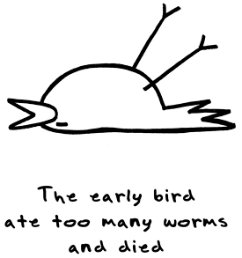
Results: adult telomere length
Adult telomeres shorten with age
Age: t_{1,211.6} =-3.88, P<0.0001
REML model with bird identity as random effect, R² =0.26
Loss = 120b ± 30.1 SE per year
Length predicts survival to next year
Independent of their age
Telomere: χ²=9.62, P<0.01
Age: χ²=0.64, P=0.42
Notes:
The slope within individuals (black line) was not significantly different to the slope between individuals (dotted line). To analyse whether the relationship between telomeres and age was comparable within and between individuals, we split the age variable into two terms for each bird: the mean age (ß_{B}; Fig. 1c); and deviation from the mean age (Δ age or ß_{W}; Fig. 1d).
Within and between individual slopes did not significantly differ (F_{1,369} = 0.45, P=0.50).

Slide 41
Results: adult telomere length
Adult telomeres shorten with age
Age: t_{1,211.6} =-3.88, P<0.0001
REML model with bird identity as random effect, R² =0.26
Loss = 120b ± 30.1 SE per year
Length predicts survival to next year
Independent of their age
Telomere: χ²=9.62, P<0.01
Age: χ²=0.64, P=0.42
Length predicts post sampling lifespan
Last sample used for all individuals
Age χ²=6.35, P<0.05
Telomeres χ²=3.83, P<0.05
Notes:
The slope within individuals (black line) was not significantly different to the slope between individuals (dotted line). To analyse whether the relationship between telomeres and age was comparable within and between individuals, we split the age variable into two terms for each bird: the mean age (ß_{B}; Fig. 1c); and deviation from the mean age (Δ age or ß_{W}; Fig. 1d).
Within and between individual slopes did not significantly differ (F_{1,369} = 0.45, P=0.50).

Slide 42
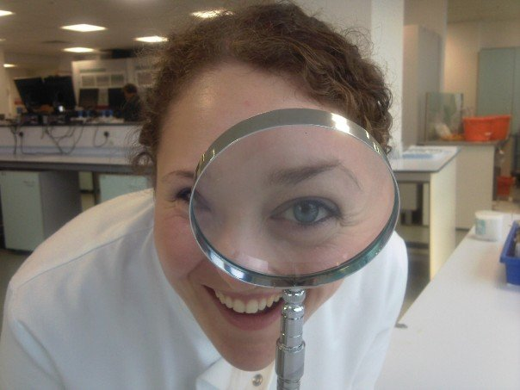
Dr Emma Barrett

